Slide 1

Exercise 3 - ITEMIS Create: Modelling the ATM behaviour
Saccotelli Leonardo - 761047

Slide 2
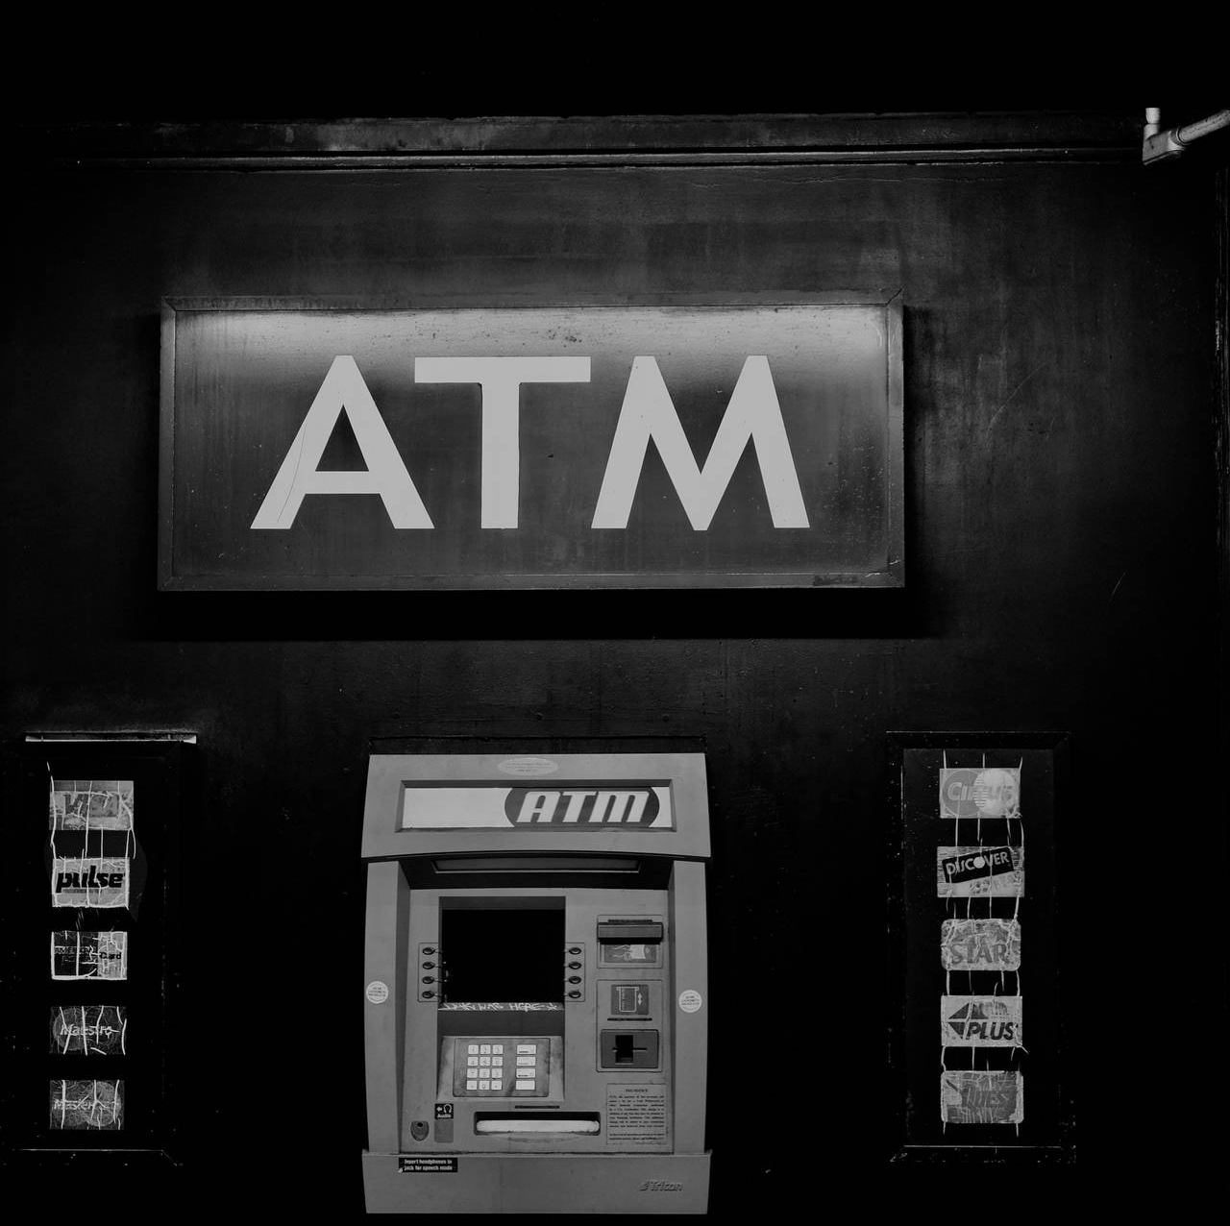
Goal
Implement the ATM behaviour using the Harel State Charts formalization.
Three of the most common activities have been implemented:
Money Withdrawal
Money Deposit
Account Balance

Slide 3

Model Logic
The State Machine is divided into two main sections:
The Card-Handling Logic
The ATM Logic

Slide 4
Card-Handling Logic
In this region, the logic for handling the card is defined:
Initially, the machine is in the Idle state, waiting for the user to insert a card. As soon as the machine enters this state, the counterBlockCard and pinInserted variables are reset.
When the User.insertCard event is triggered, the machine transitions to a composite state called CustomerRequest to process the user’s request.
Regardless of the user’s request, once it has been processed the machine transitions to the EjectCard state.
The user can retrieve its card within 30 seconds and the machine goes back to the Idle state.
If the user do not retrieve its card within 30 seconds, the ATM.blockCard is fired, the machine enters in the BlockedCard state and after 5 seconds it goes back to the Idle state.

Slide 5
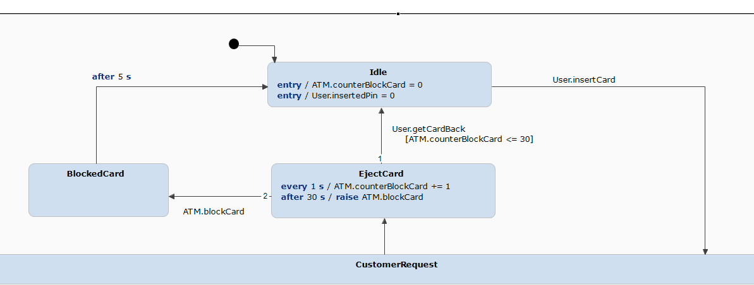
Card-Handling Logic

Slide 6
ATM Logic: CustomerRequest
In this region, the logic for handling the user’s request is defined:
After the User.insertCard event the machine enters in a composite state called CustomerRequest. Two consequential composite state are defined:
CustomerAuthentication
CustomerTransaction

Slide 7
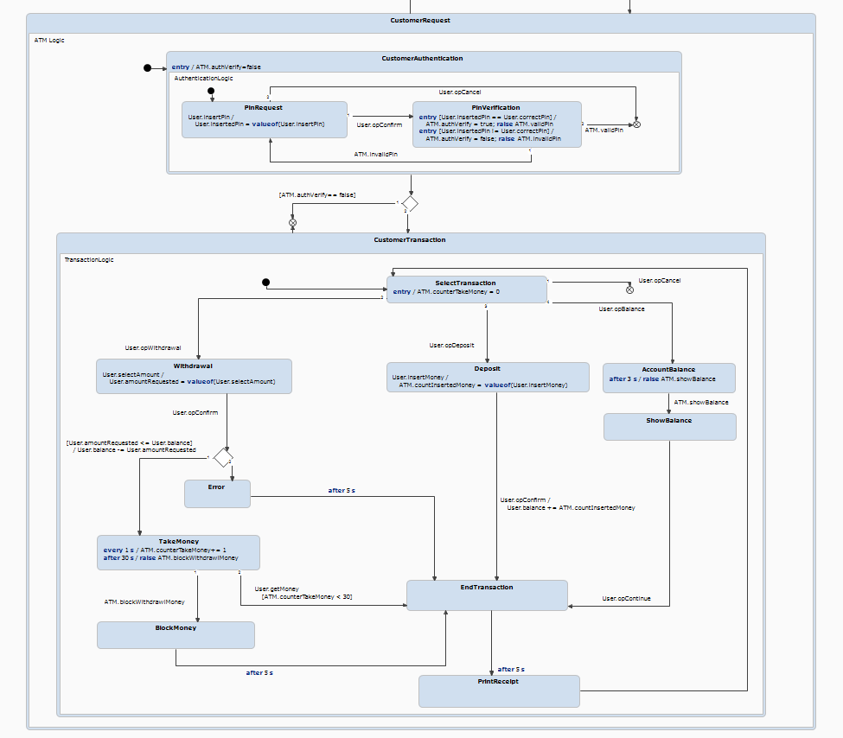
ATM Logic: CustomerRequest

Slide 8
ATM Logic: CustomerAuthentication
In this composite state, Customer authentication operations are performed at the ATM.
Initially, the authVerify boolean variable is initialized to FALSE;
The first state is the PinRequest where the PIN of the inserted card is requested.
The user confirms the inserted PIN.
In the PinVerification state the system check if the inserted PIN is equal or not to the correct PIN for that card.
If the PIN is valid, the ATM.validPin is triggered and the system exit from the CustomerAuthentication state and enters into the CustomerTransaction state.
If the PIN is not valid, the ATM.invalidPin is triggered and the system goes back to the PinRequest state.
In addition, we can exit from the system using the Cancel operation.

Slide 9
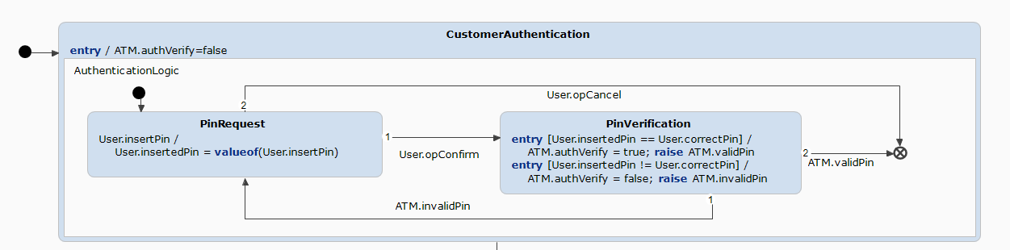
ATM Logic: CustomerAuthentication

Slide 10
ATM Logic: CustomerTransaction
In this composite state the customer's transaction operations are performed at the ATM. This state can only be reached if CustomerAuthentication has been completed successfully.
Initially, we are in the SelectTransaction state. We can perform three operations: Withdrawal, Deposit, AccountBalance or just Cancel and quit.
From AccountBalance the system goes to the ShowBalance state. Then, the EndTransaction state is reached, the receipt is printed in the PrintReceipt state and then the system goes back to the SelectTransaction state.
From Deposit, the user enter the amount of money to deposit in the back account, confirms the operation and the money will be added to the user’s balance. The transaction ends in the EndTransaction state

Slide 11
ATM Logic: CustomerTransaction
From Withdrawal, the user select an amount of money and confirm the operation.
If the amount of requested money is less than or equal to the user’s balance, then the operation can be performed. The system goes to the TakeMoney state. The user can retrieve the money within 30 seconds, or the money will be blocked in the BlockMoney state. The transaction ends and the receipt is printed.
Otherwise, the system enters in the Error state and the transaction is closed.

Slide 12
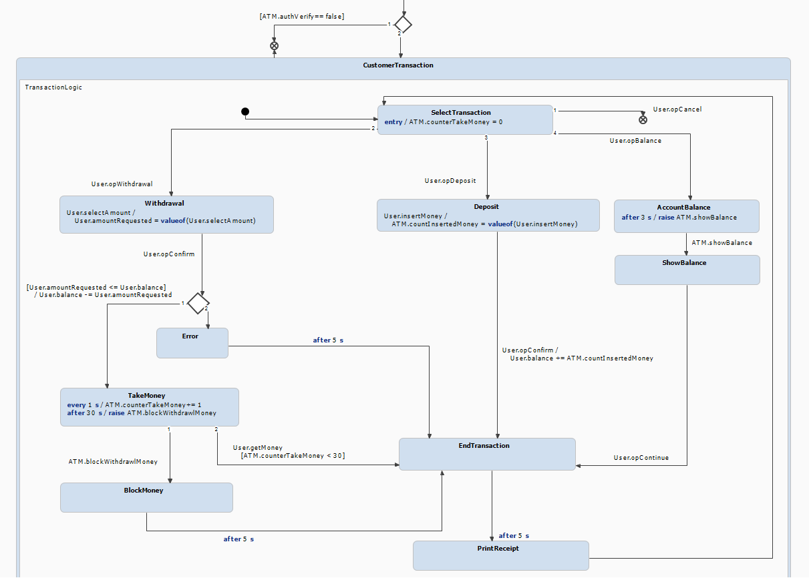
ATM Logic: CustomerTransaction

Slide 13
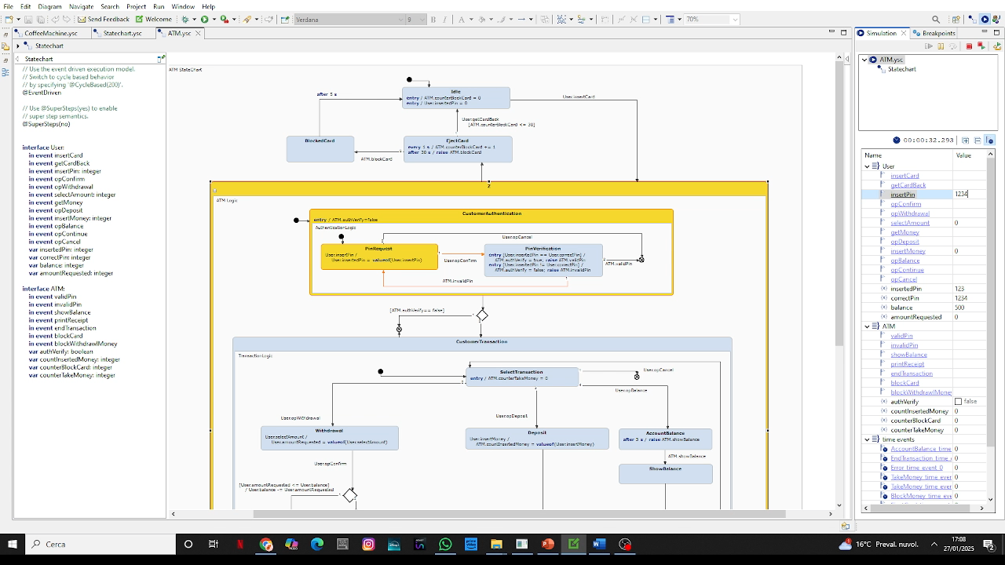
ATM: AccountBalance Operation

Slide 14
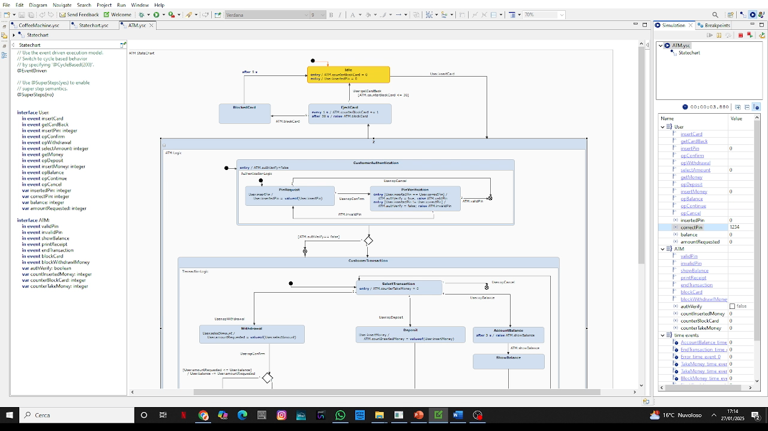
ATM: Deposit Operation

Slide 15
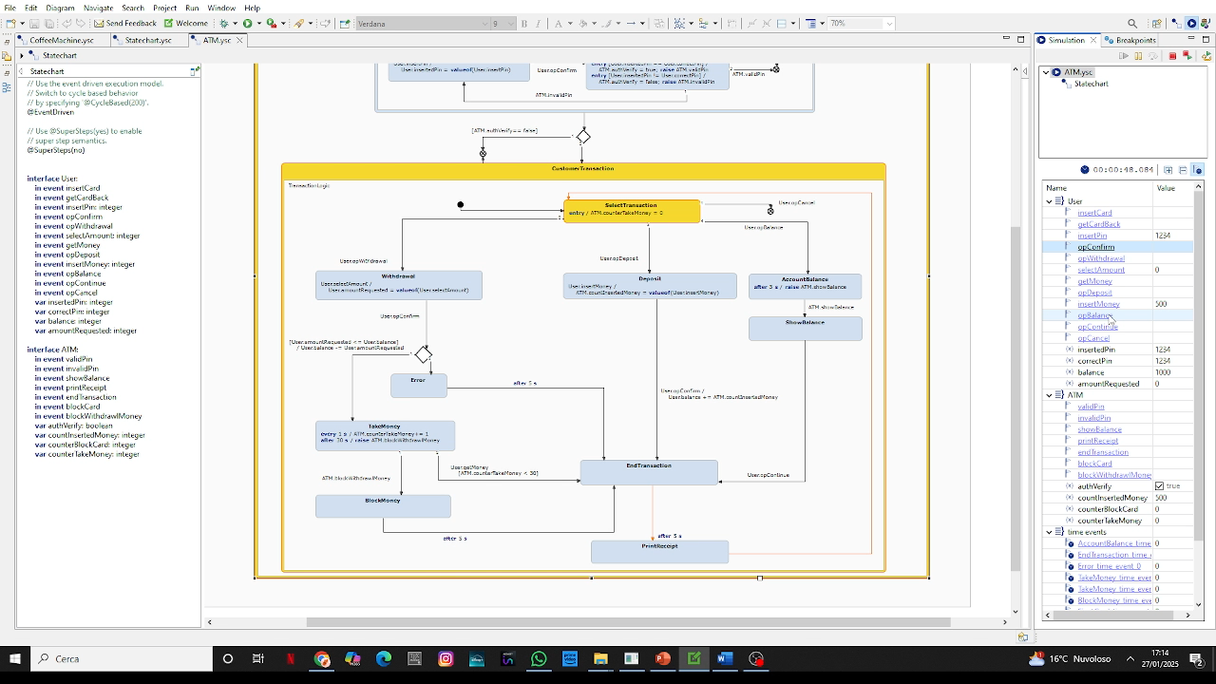
ATM: Withdrawal Operation

Slide 16
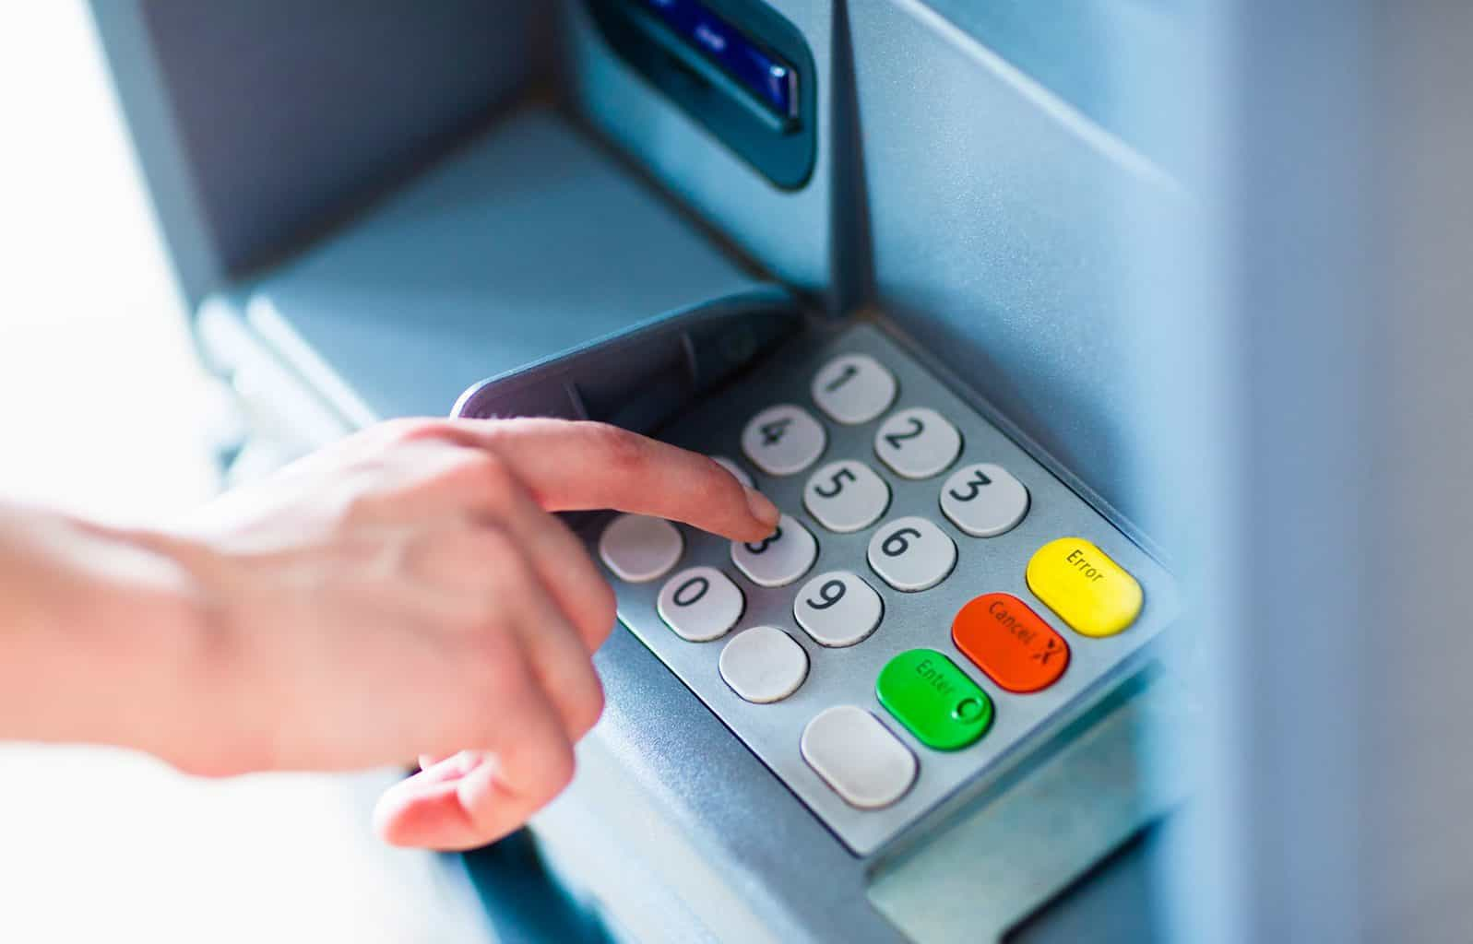
Thank for the attention Formal methods for computer science Prof. Berardina De Carolis Università degli studi di Bari Aldo Moro Computer Science
Leonardo Saccotelli
l.saccotelli@studenti.uniba.it

